Slide 1







ONLINE BOOK STORE
By Aruhi Pallavi
DataBase Management System

Slide 2






INTRODUCTION
This project focuses on building a structured, relational database system for an online bookstore using Microsoft SQL Server.
The goal is to manage books, customers, and orders efficiently while enforcing data integrity and enabling insightful sales analysis.
Automates inventory updates (e.g., stock reduction after orders) and generates sales reports
Built using SQL Server with features like constraints, triggers, stored procedures, and advanced queries.

Slide 3


DATASET OVERVIEW
THE DATASET CONSIST OF FOLLOWING TABLES:
BOOKS
CUSTOMERS
ORDERS
Fields: Title, Author, Genre, Published Year, Price, Stock
Purpose: Stores book inventory and pricing
Fields: Name, Email, Phone, City, Country
Purpose: Stores buyer information and demographics
Fields: Customer ID, Book ID, Order Date, Quantity, Total Amount
Purpose: Tracks transactions and revenue
Data was bulk imported from CSV files and structured to enforce consistency through constraints and relationships.

Slide 4



OBJECTIVES
The objective of this SQL-based project is to create a robust database that:
Efficiently stores and retrieves inventory, sales, and customer data
Analyze sales trends, customer behavior, and inventory status.
Automate stock updates using triggers.
Provides insightful analytics to understand sales trends
Helps identify high-performing books, authors, and customers
Ultimately, the goal is to support a scalable e-commerce
backend for an online bookstore.

Slide 5
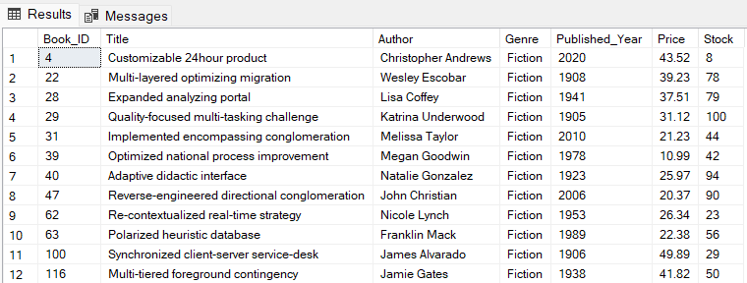


ANALYSIS
Which books belong to Fiction?
SELECT *
FROM Books
WHERE Genre = 'Fiction';
What is the total stock of all books combined?
SELECT
SUM(Stock) AS Total_Stock
FROM Books;
*Results truncated for brevity.

Slide 6

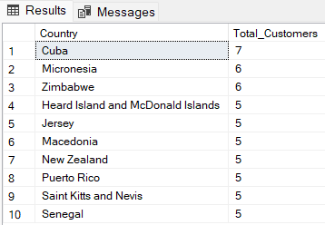
What is the total revenue?
SELECT
SUM(Total_Amount) AS Revenue FROM Orders;
How are customers distributed globally?
SELECT TOP 10
Country,
COUNT(Customer_ID) AS Total_Customers
FROM Customers
GROUP BY Country
ORDER BY Total_Customers DESC;

Slide 7
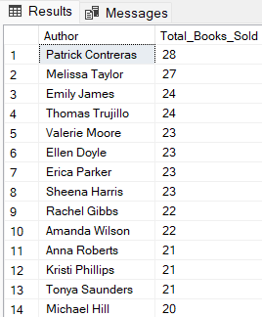
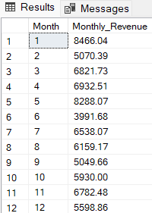
Which authors sold the most books?
SELECT b.Author, SUM(o.Quantity) AS Total_Books_Sold
FROM Orders o
INNER JOIN Books b ON o.Book_ID = b.Book_ID
GROUP BY b.Author
ORDER By Total_Books_Sold DESC;
What is the monthly sales trend?
SELECT
MONTH(Order_Date) AS Month,
SUM(Total_Amount) AS Monthly_Revenue
FROM Orders
GROUP BY MONTH(Order_Date)
ORDER BY Month;
*Results truncated for brevity.

Slide 8

What percentage of customers are Repeaters?
WITH RepeatCustomers AS (
SELECT
Customer_ID,
COUNT(Order_ID) AS Total_Orders
FROM Orders
GROUP BY Customer_ID
HAVING COUNT(Order_ID) > 1
)
SELECT
(COUNT(*) * 100.0 / (SELECT COUNT(*) FROM Customers)) AS Repeat_Customer_Percentage
FROM RepeatCustomers;

Slide 9


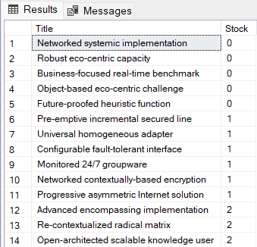

How is stock updated after an order?
CREATE TRIGGER trg_UpdateStock
ON Orders
AFTER INSERT
AS
BEGIN
SET NOCOUNT ON;
UPDATE b
SET Stock = b.Stock - i.Quantity
FROM Books b
INNER JOIN inserted i ON b.Book_ID = i.Book_ID;
END;
Which books are low in stock?
SELECT
Title,
Stock
FROM Books
WHERE Stock < 10
ORDER BY Stock ASC;

Slide 10

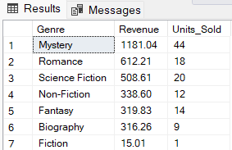
Generate a monthly sales report (Nov 2023)
CREATE PROCEDURE usp_GenerateMonthlyReport
@Month INT,
@Year INT
AS
BEGIN
SET NOCOUNT ON;
SELECT
b.Genre,
SUM(o.Total_Amount) AS Revenue,
SUM(o.Quantity) AS Units_Sold
FROM Orders o
INNER JOIN Books b ON o.Book_ID = b.Book_ID
WHERE MONTH(o.Order_Date) = @Month
AND YEAR(o.Order_Date) = @Year
GROUP BY b.Genre
ORDER BY Revenue DESC;
END;
EXEC usp_GenerateMonthlyReport @Month = 11, @Year = 2023;

Slide 11
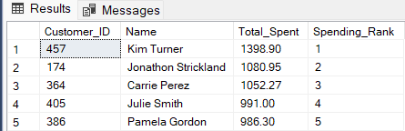
Who are the top 5 customers by spending?
WITH CustomerSpending AS (
SELECT
c.Customer_ID,
c.Name,
SUM(o.Total_Amount) AS Total_Spent,
RANK() OVER (ORDER BY SUM(o.Total_Amount) DESC) AS Spending_Rank
FROM Customers c
INNER JOIN Orders o ON c.Customer_ID = o.Customer_ID
GROUP BY c.Customer_ID, c.Name
)
SELECT TOP 5 *
FROM CustomerSpending
ORDER BY Spending_Rank;

Slide 12

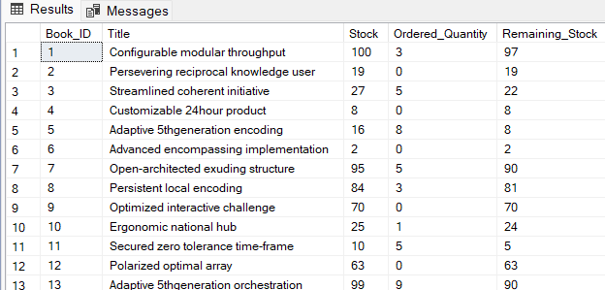
What is the remaining stock after orders?
SELECT
b.Book_ID,
b.Title,
b.Stock,
ISNULL(SUM(o.Quantity), 0) AS Ordered_Quantity,
b.Stock - ISNULL(SUM(o.Quantity), 0)
AS Remaining_Stock
FROM Books b
LEFT JOIN Orders o ON b.Book_ID = o.Book_ID
GROUP BY b.Book_ID, b.Title, b.Stock
ORDER BY b.Book_ID;

Slide 13

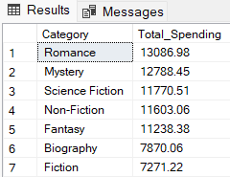
What genres generate the highest revenue?
SELECT
b.Genre AS Category,
SUM(o.Total_Amount) AS Total_Spending
FROM Books b
JOIN Orders o ON b.Book_ID = o.Book_ID
GROUP BY b.Genre
ORDER BY Total_Spending DESC;

Slide 14


KEY INSIGHTS
Geographic Distribution
Top Countries: Cuba (7 customers), Micronesia (6), Zimbabwe (6).
Insight: Customer base is globally distributed but sparse. Consider localized marketing campaigns in these regions.
Revenue Trends
Peak Month: May ($8,288.07).
Lowest Month: June ($3,991.68).
Insight: Seasonal promotions in May drove sales. June may require discounts or events to boost demand
Genre Performance
Top Genres: Romance (13,086.98),Mystery(13,086.98),Mystery(12,788.45).
Underperformer: Fiction ($7,271.22) despite having the most books.
Insight: Promote Fiction through bundles or discounts. Invest in high-revenue genres like Romance.

Slide 15
KEY INSIGHTS
Inventory Alerts
Critical Stock: Books like "Networked systemic implementation" (Stock=0) need urgent restocking.
Action: Use the Low-Stock Alerts query to automate reorder triggers.
Customer Loyalty
Repeat Customers: 27.8% of total customers.
Top Spender: Kim Turner ($1,398.90).
Insight: Launch a loyalty program for repeat buyers. Recognize top spenders with exclusive offers.
Author Popularity
Top Author: Patrick Contreras (28 books sold).
Strategy: Feature bestselling authors on the homepage or in newsletters.

Slide 16
CONCLUSIONS
Database Effectiveness
Automation: Triggers and stored procedures (e.g., stock updates, monthly reports) ensure real-time accuracy.
Analytics: Queries provide actionable insights into sales trends, inventory, and customer behavior.
Business Recommendations
Inventory: Prioritize restocking for low-stock books like "Advanced encompassing implementation".
Marketing: Target high-revenue genres (Romance, Mystery) and promote underperforming categories (Fiction).
Retention: Improve the 27.8% repeat customer rate with personalized discounts or a points system.

Slide 17
CONCLUSIONS
Future Enhancements
Demographic Analysis: Add age/occupation data to tailor recommendations.
Dynamic Pricing: Adjust Fiction book prices based on demand.
Loyalty Program: Integrate a rewards system into the database.

Slide 18



THANK YOU FOR WATCHING
ARUHI PALLAVI
960-888-0418
PALLAVIARUHI@GMAIL.COM

